Slide 1
Materials Manufacturing (EDPT 601)
Tutorial 5 ( Welding )
By: Prof. Dr. Nahed El-Mahallawy
Eng. Mahmoud Badr

Slide 2
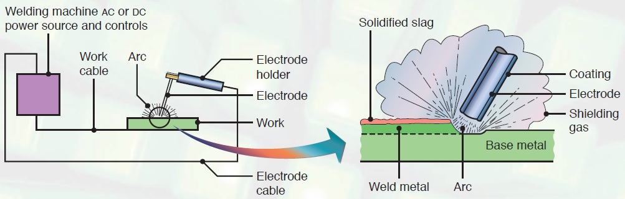
Shielded Metal Arc Welding (SMAW)
Introduction
One of the oldest and simplest ways of versatile joining processes
About 50% of the industrial and maintenance is performed by this welding process
Low cost equipment
A finite electrode which consists of a metal wire usually from 1.5 to 6.5 mm diameter and 20 to 45 cm length

Slide 3
Functions of the wire electrode coating
It vaporize to provide a protective atmosphere (shielding).
Acting as flux to deoxidize and remove impurities from molten metal.
Adding alloying elements.
Adding filler materials.
Influence the shape of weld bead.
Affect arc penetration.
Provide ionizing elements to help stabilizing the arc.
Reduce weld metal spatter and increase efficiency of deposition.
Main Applications
Useful for work in remote areas where portable fuel- powered generator can be used for power supply.
General construction.
Ship building.
Pipe lines.
Maintenance work.

Slide 4
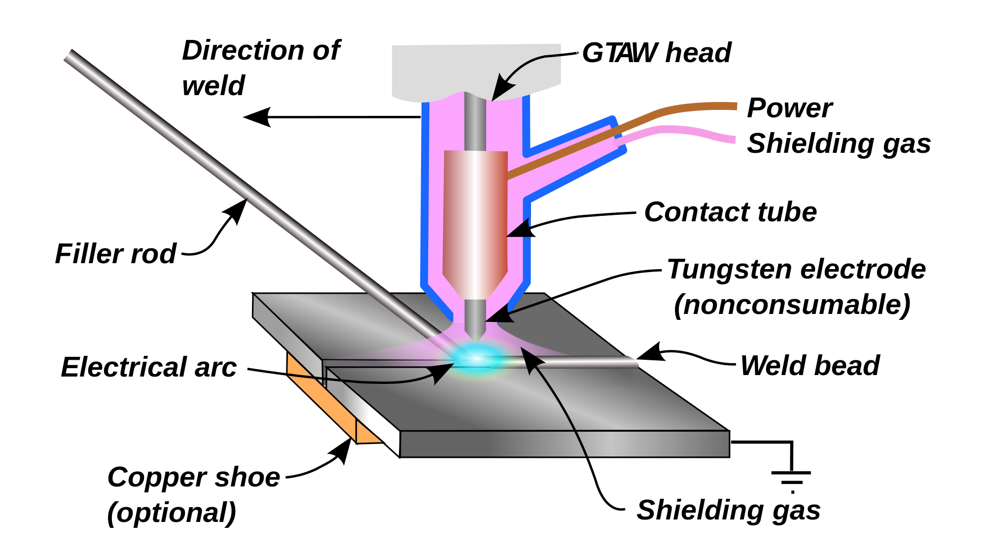
Gas Tungsten Arc Welding (GTAW) Tungsten Inert Gas (TIG)
Introduction
Gas tungsten arc welding (GTAW), also known as tungsten inert gas (TIG) welding, is an arc welding process that uses a non-consumable tungsten electrode to produce the weld.
The weld area and electrode is protected from oxidation or other atmospheric contamination by an inert shielding gas (argon or helium).
A filler metal is normally used, though some welds, known as autogenous welds, do not require it.
Main Applications
Used to weld thin sections of stainless steel and non-ferrous
metals such as aluminum, magnesium, and copper alloys.
Aerospace industry is one of the primary users of
gas tungsten arc welding
It is also frequently employed to weld small-diameter,
thin-wall tubing such as those used in the bicycle industry.

Slide 5
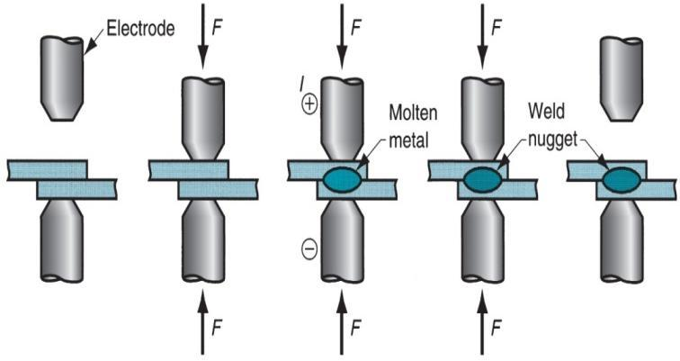
Resistance Spot Welding (RSW)
Introduction
Resistance spot welding (RSW), is a process in which contacting metal surface points are joined by the heat obtained from resistance to electric current.
Work-pieces are held together under pressure exerted by electrodes
It is a from of a solid state welding
The whole process can be fully automated
No fillers and flux or shielding gases needed

Slide 6
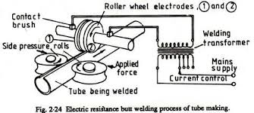
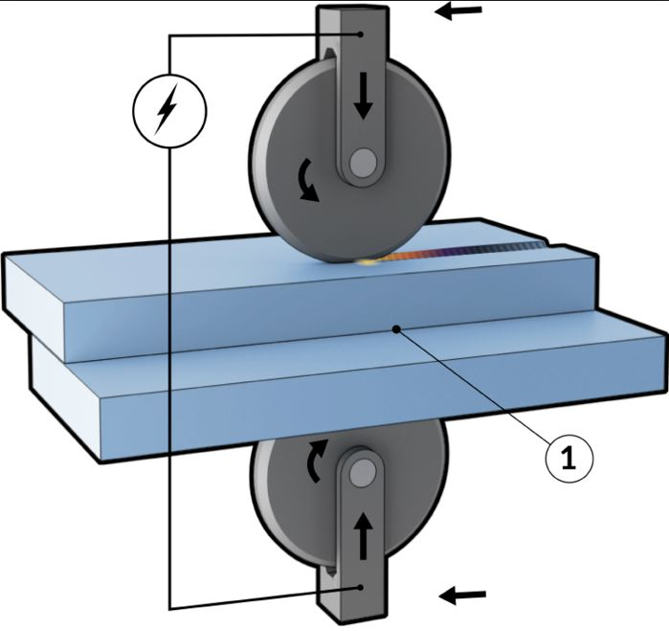
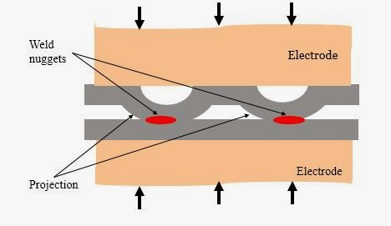
Main Applications
Spot welding is typically used when welding particular types of sheet metal and wire mesh.
The most common application of spot welding is in the automobile manufacturing industry.
Spot welding is also used in the orthodontist's clinic.
Spot welding can be used for attaching braces, pads or clips with cases, bases and covers which are mainly product of sheet metal forming.
Types of resistance welding
Resistance butt welding of tubes fig. 2.24.
Seam welding fig. 2.25
Projection welding fig. 2.26
fig. 2.25 Seam welding
fig. 2.26 Projection Welding

Slide 7
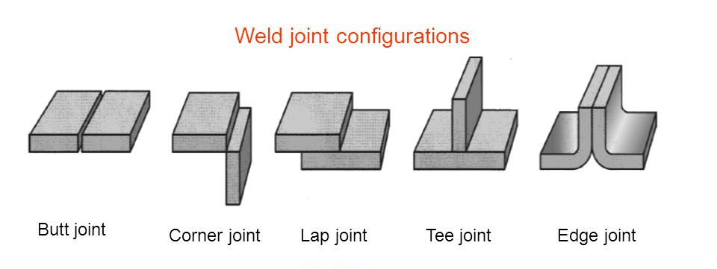
Basic Joints Design

Slide 8
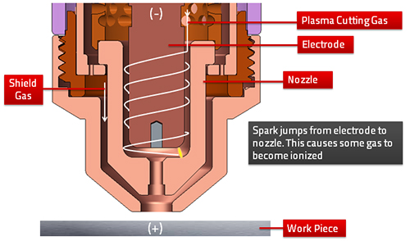
Plasma Cutting
Introduction
Plasma cutting is a process that cuts through electrically conductive materials by means of an accelerated jet of hot plasma
Typical materials cut with a plasma torch include steel, Stainless steel, aluminum, brass and copper, although other conductive metals may be cut as well

Slide 9
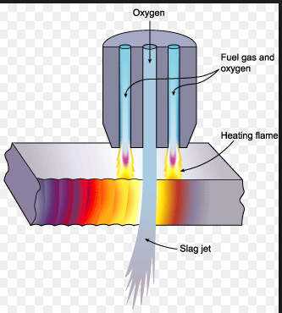
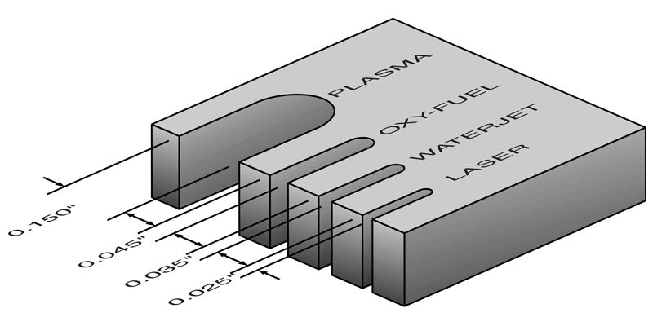
Gases used in Plasma Cutting
Argon
Helium
Nitrogen
mixtures of these gases are used for both the inner and outer shields.
Another Thermal Processes used for Cutting
Oxygen fuel gas cutting: Suitable for cutting thick steels,
can cut only low to medium carbon steels.

Slide 10
Thank You ☺

